Slide 1
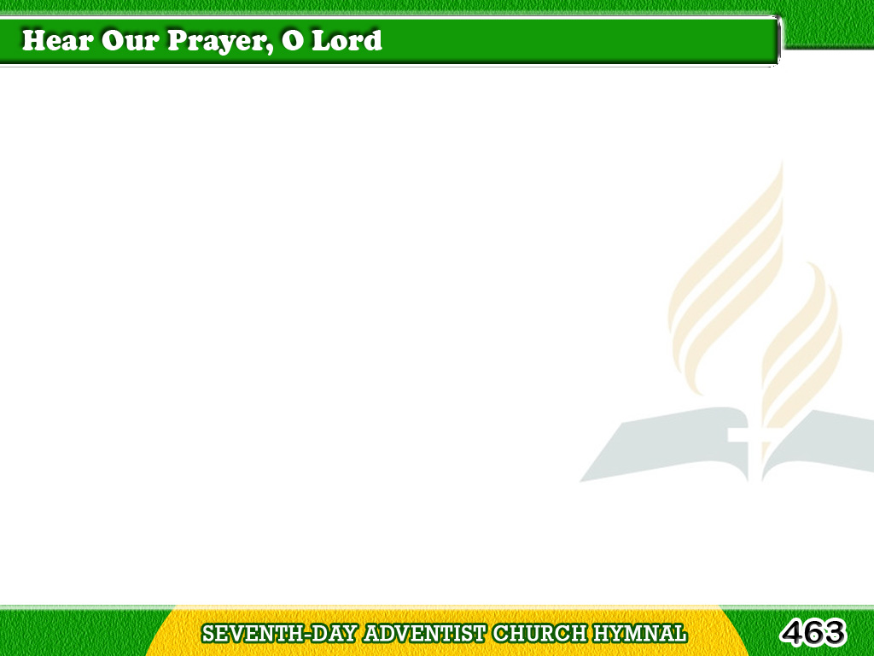
1/1
Hear our prayer, O Lord,
Hear our prayer, O Lord;
Incline Thine ear to us,
And grant us Thy peace. Amen.
Tagalog
Version

